Slide 1
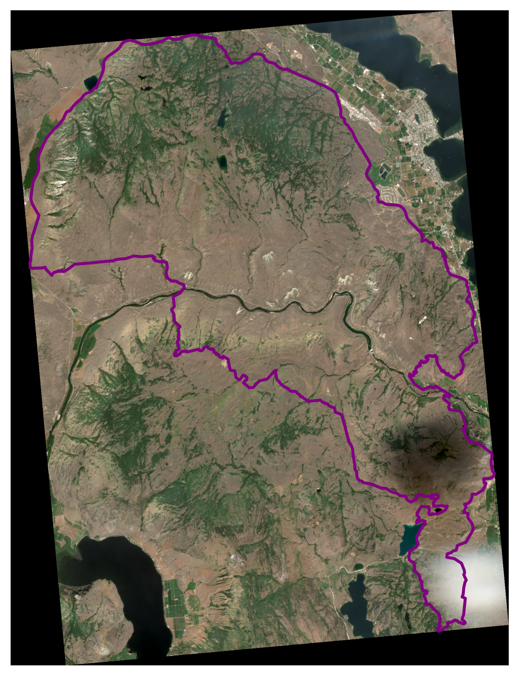
S2_2022-08-02_truecolor_pre_8bit_alt

Slide 2
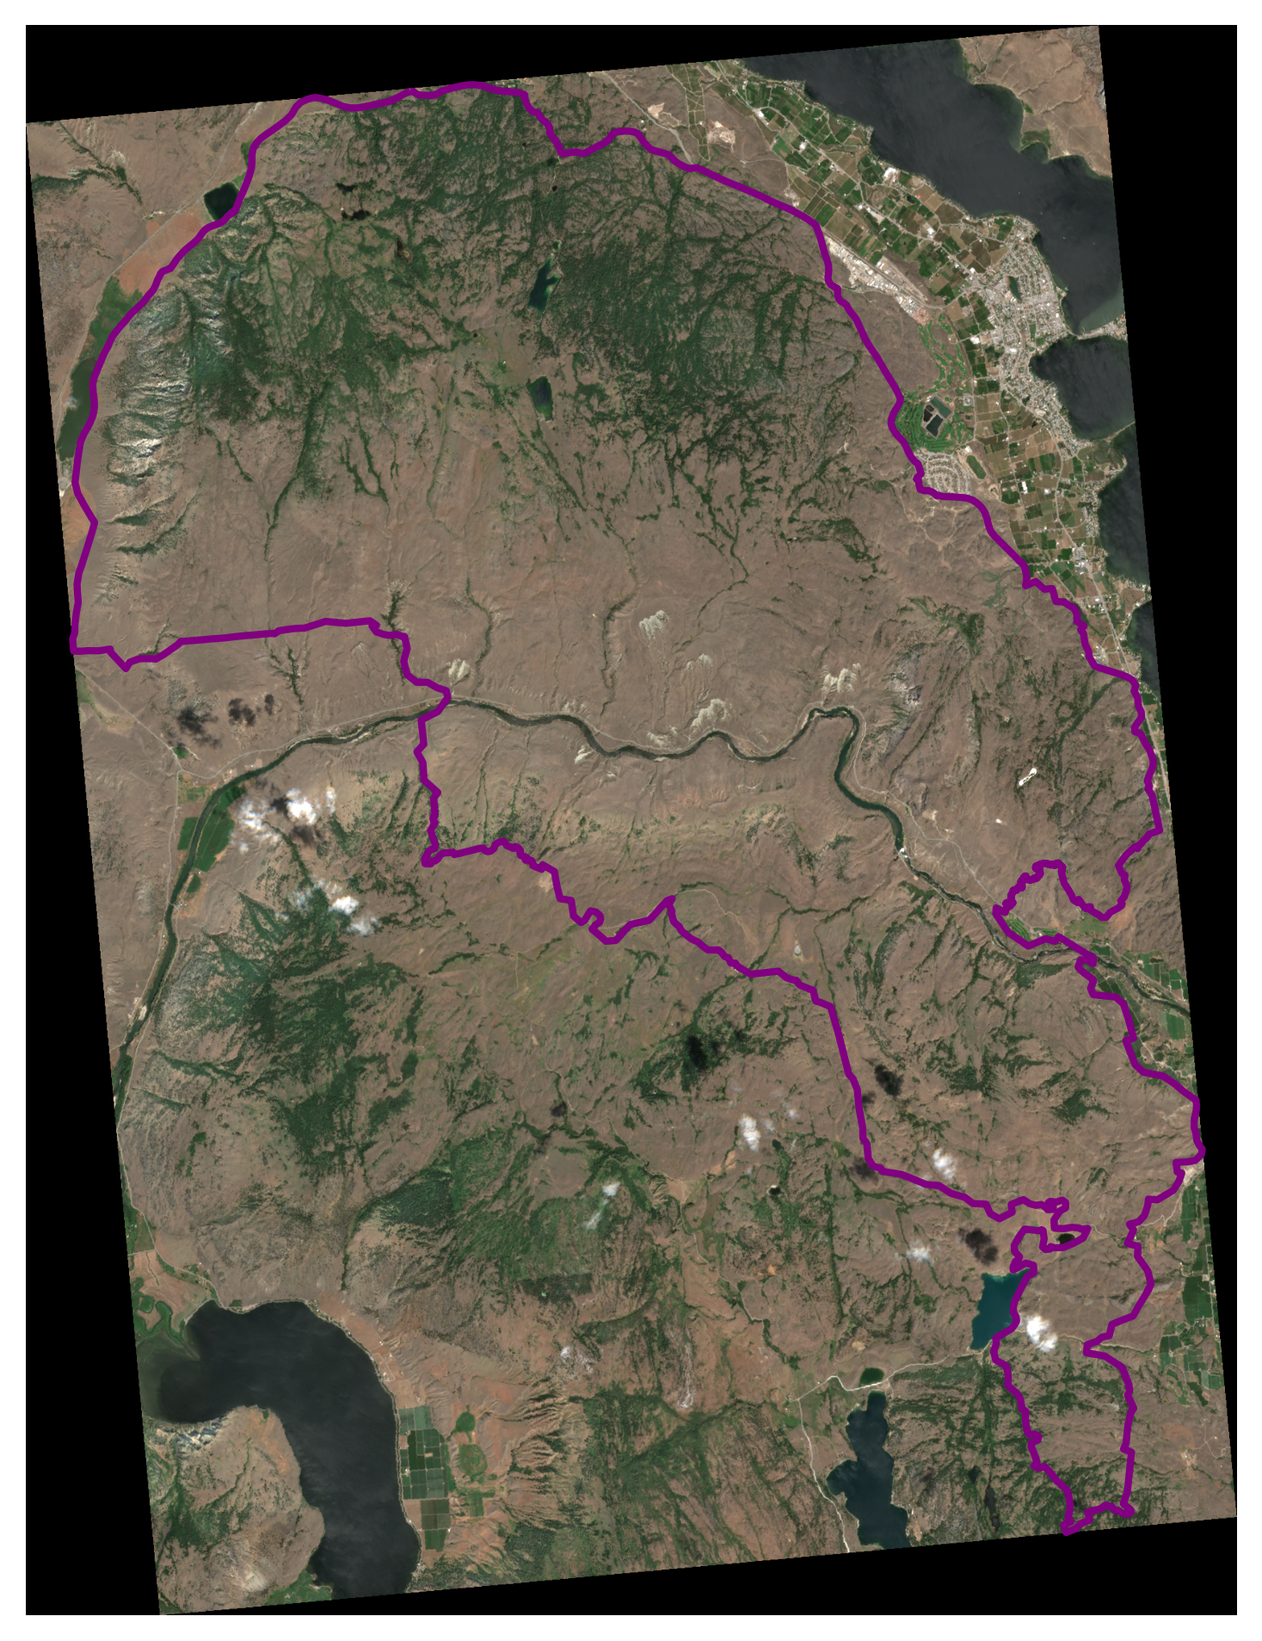
S2_2022-08-05_truecolor_pre_8bit_alt

Slide 3
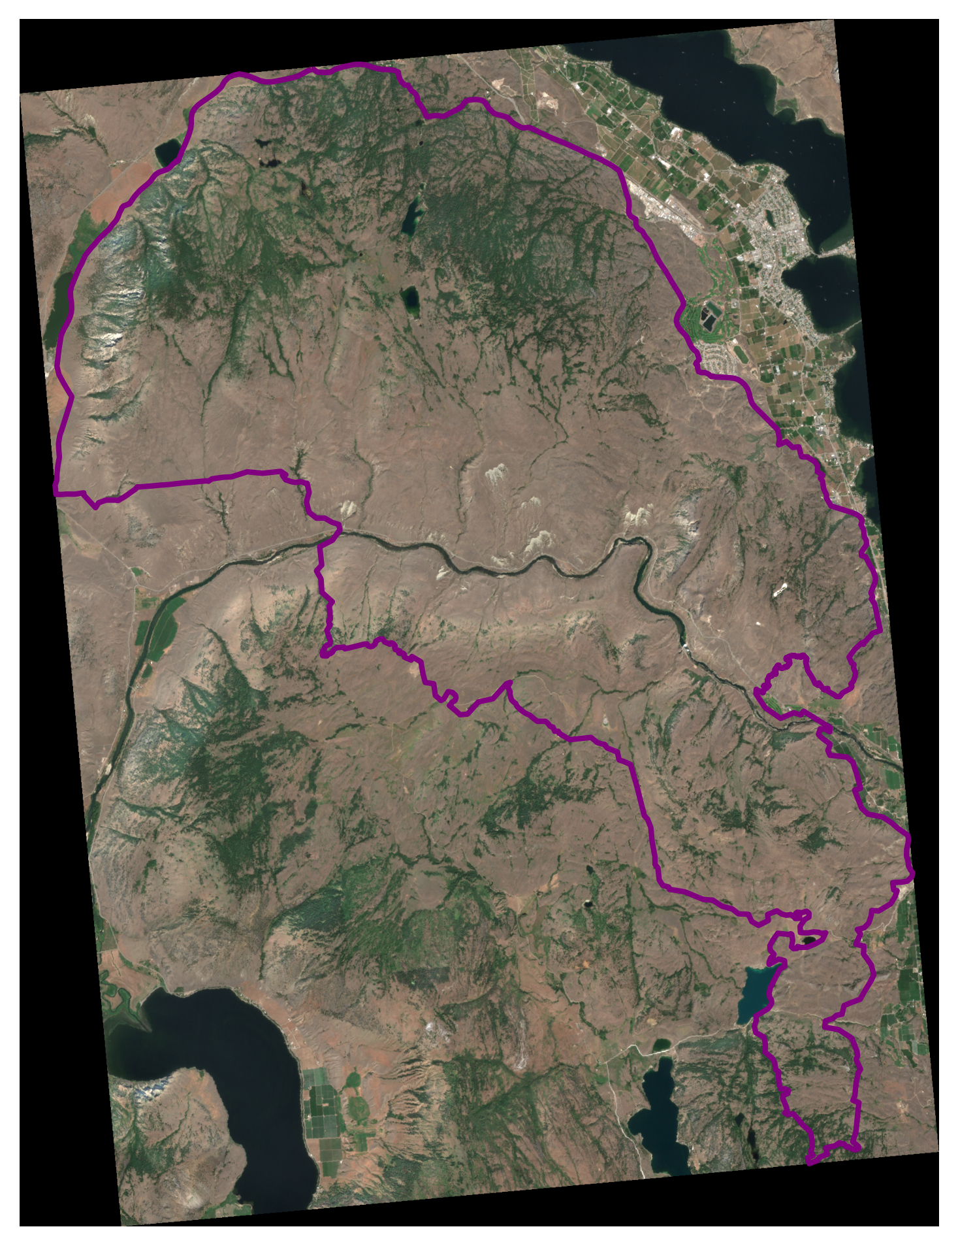
S2_2022-08-07_truecolor_pre_8bit_alt

Slide 4
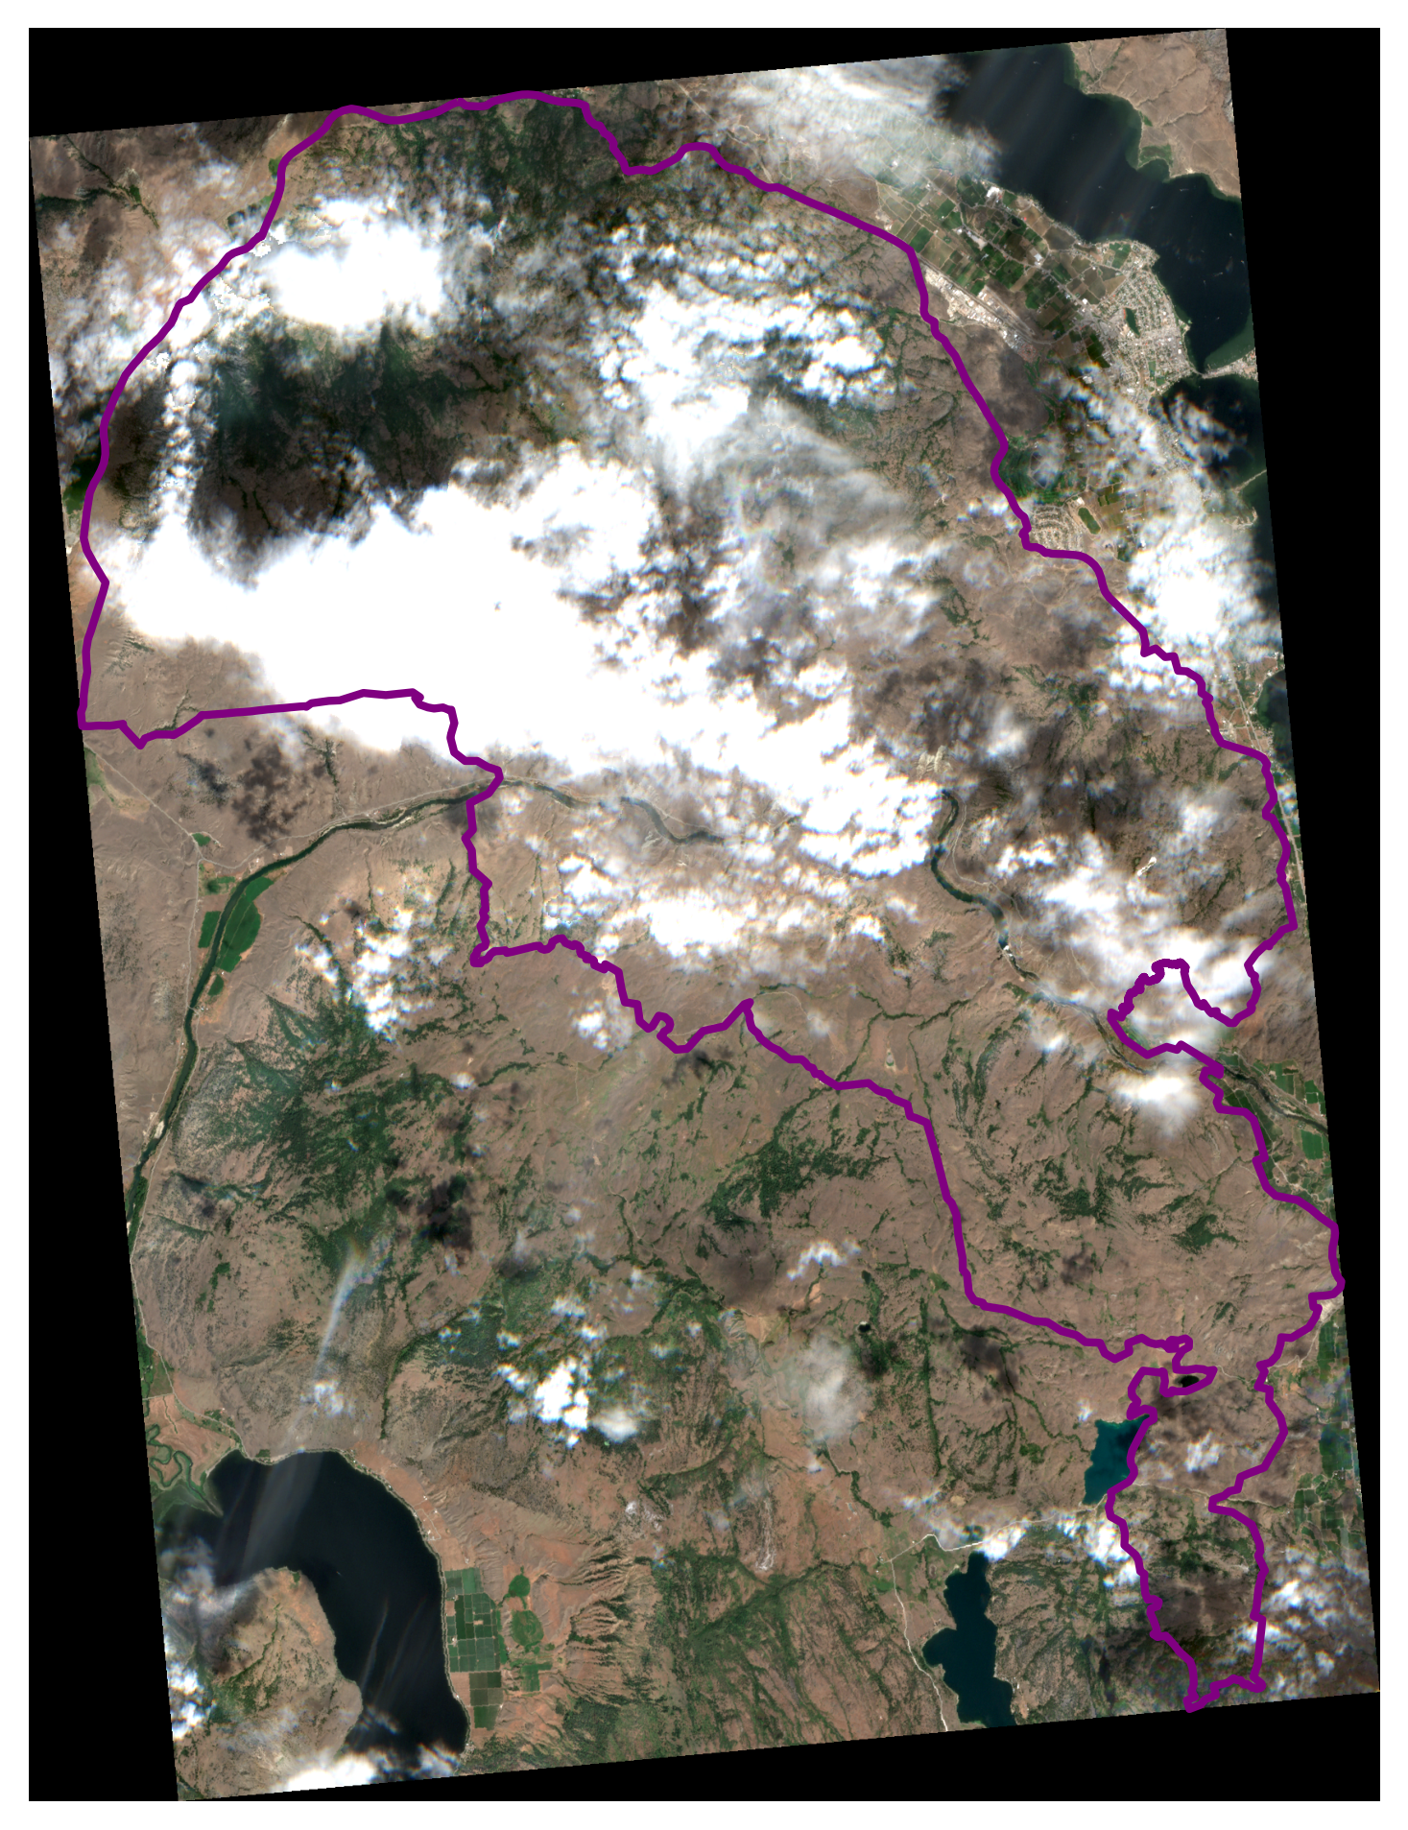
S2_2022-08-10_truecolor_pre_8bit_alt

Slide 5
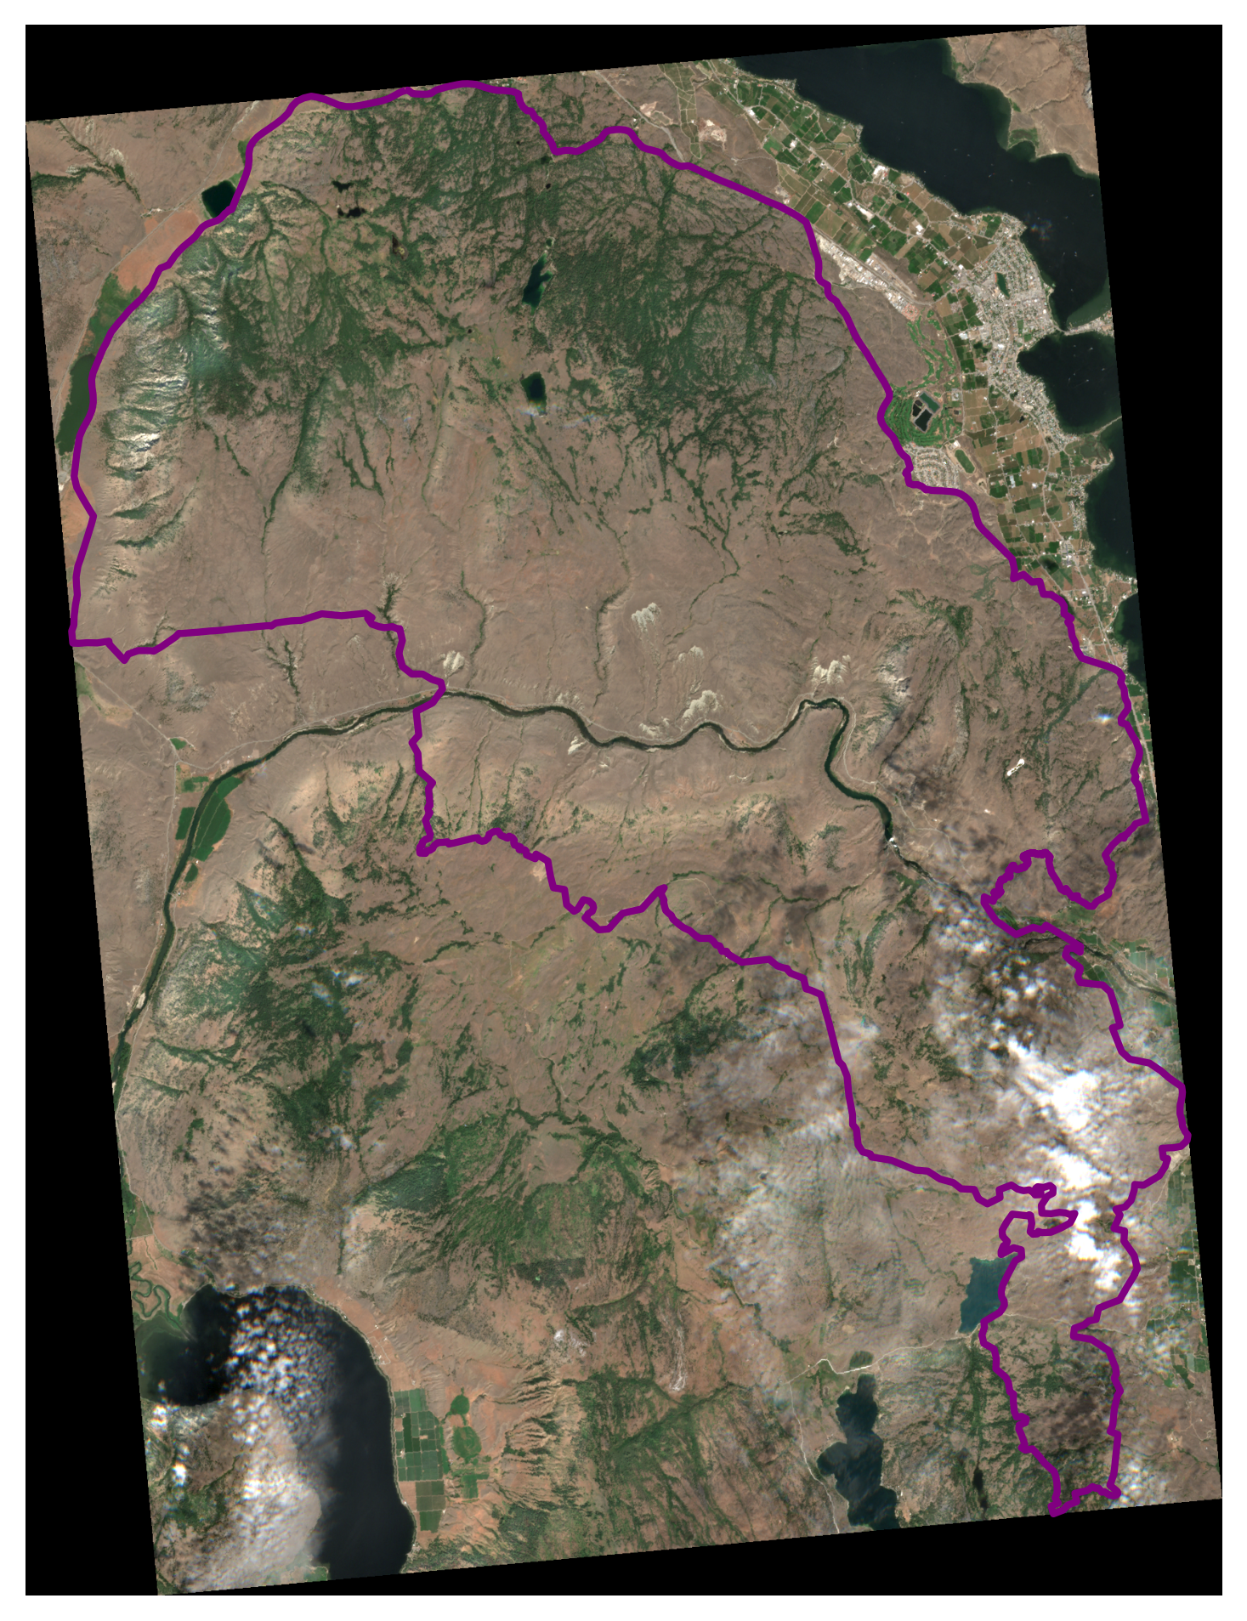
S2_2022-08-12_truecolor_pre_8bit_alt

Slide 6
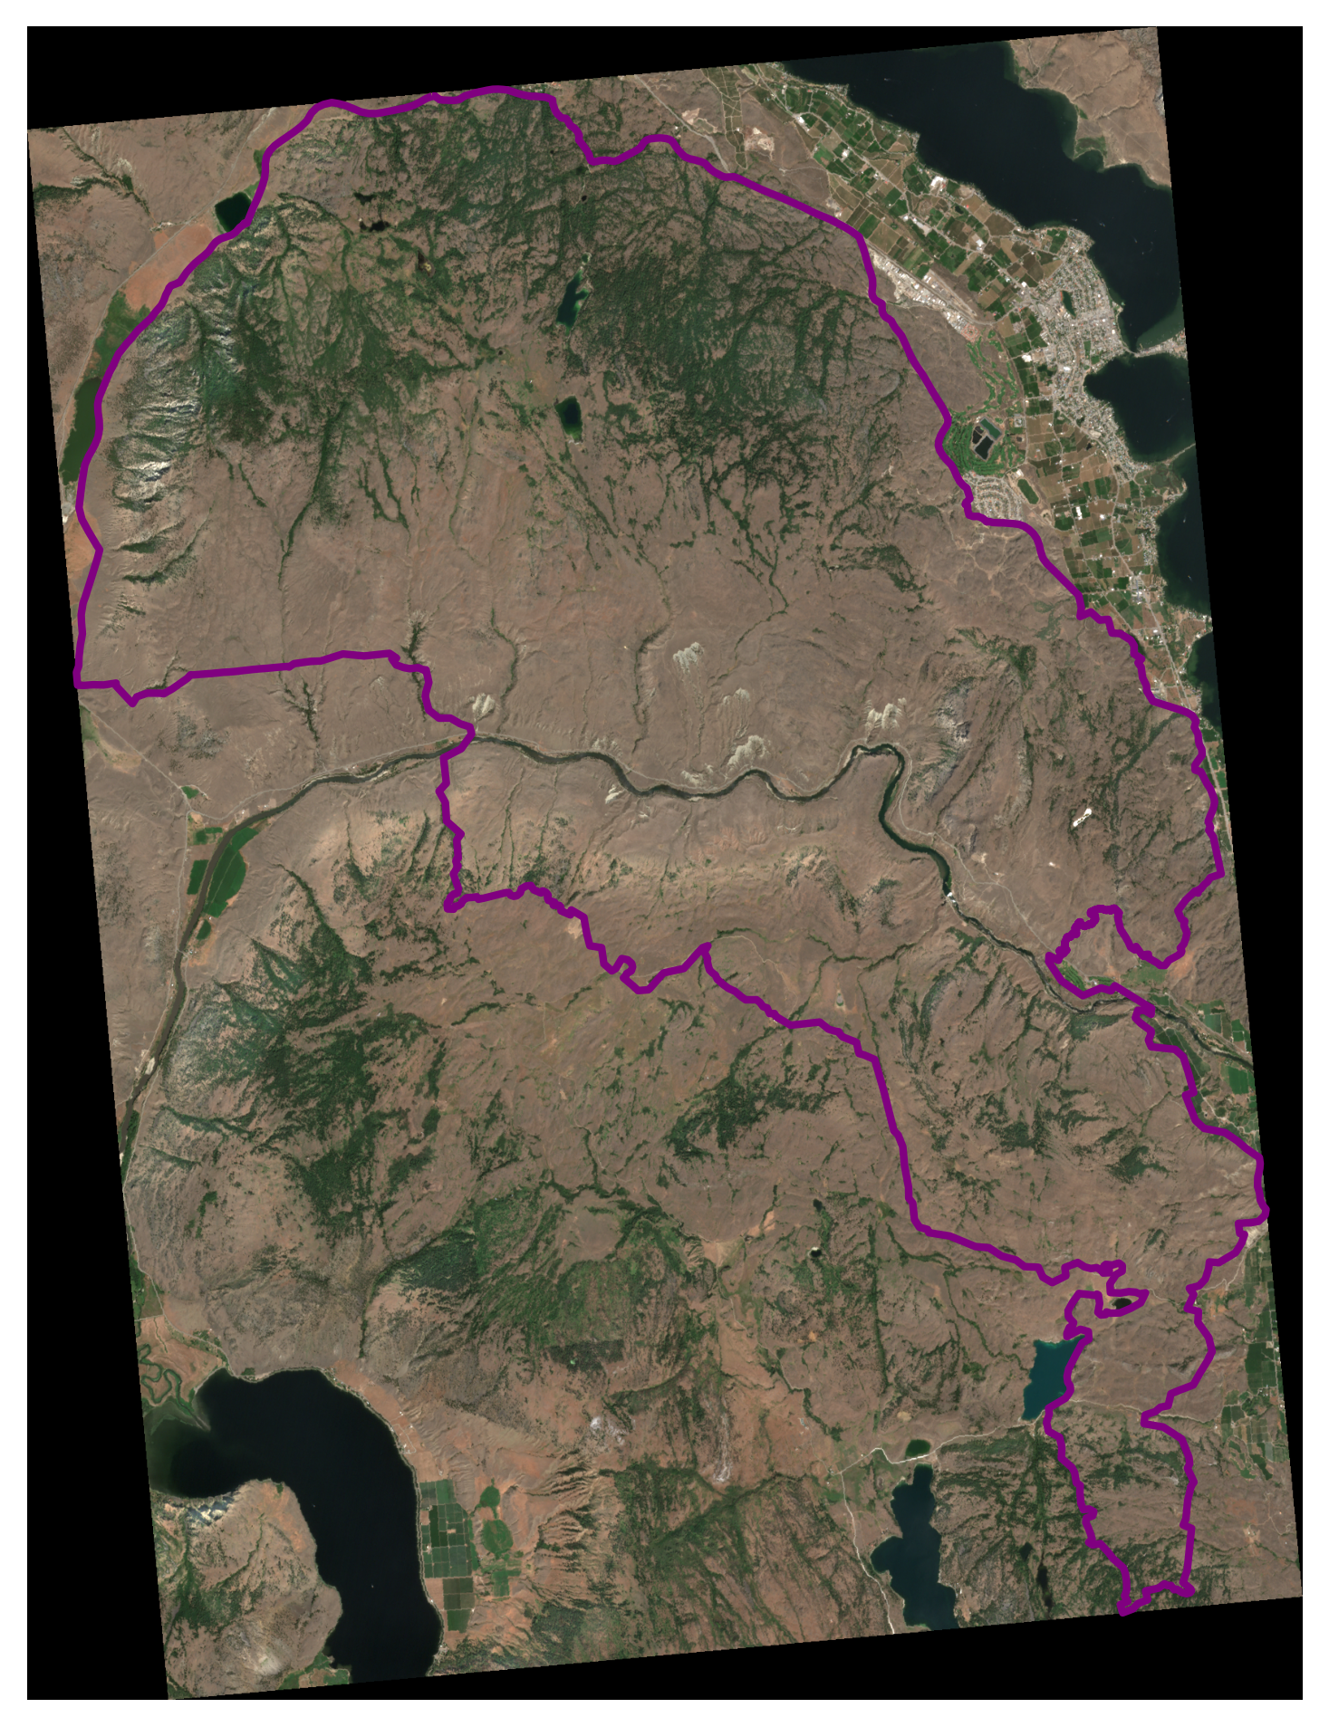
S2_2022-08-15_truecolor_pre_8bit_alt

Slide 7
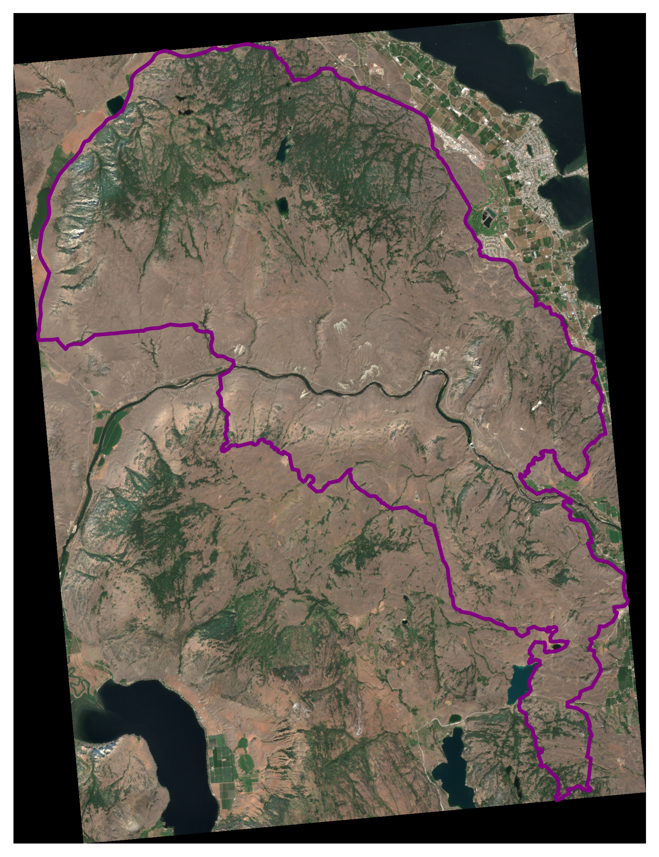
S2_2022-08-17_truecolor_pre_8bit_alt

Slide 8
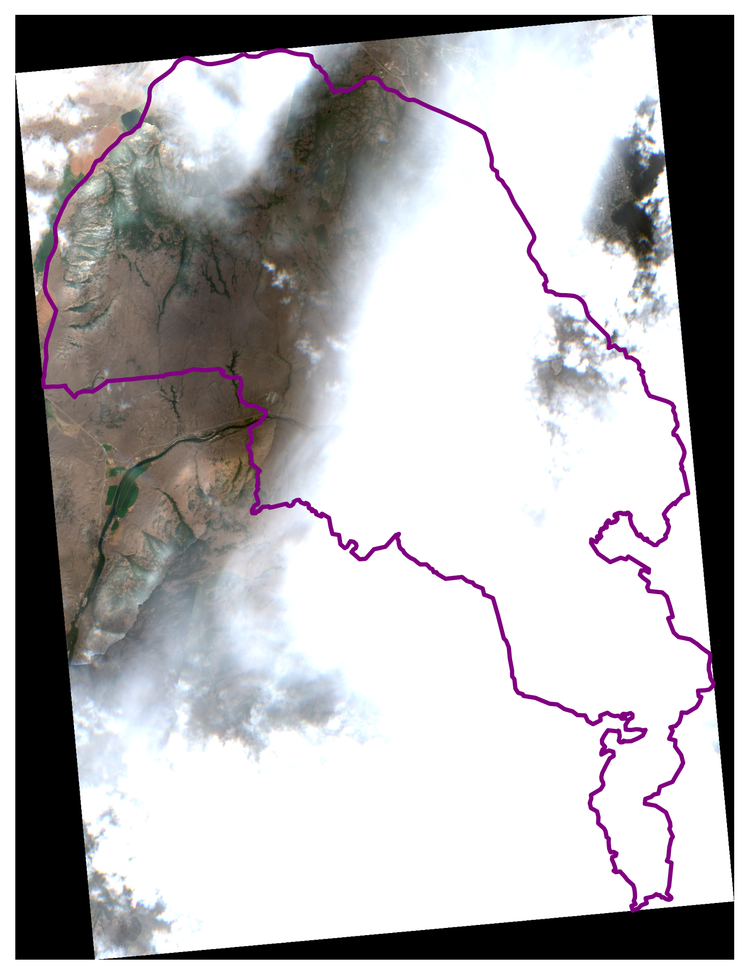
S2_2022-08-20_truecolor_pre_8bit_alt

Slide 9
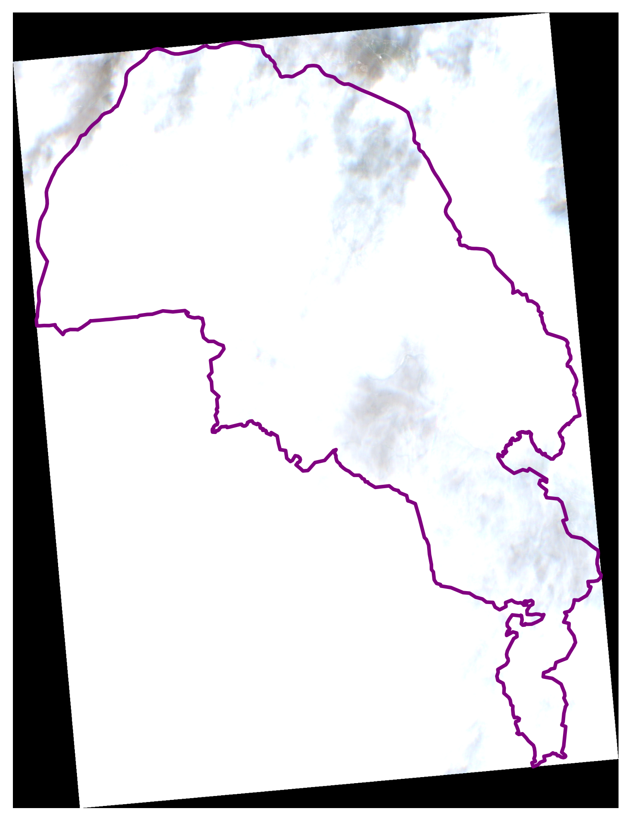
S2_2022-08-22_truecolor_pre_8bit_alt

Slide 10

S2_2022-08-25_truecolor_pre_8bit_alt

Slide 11
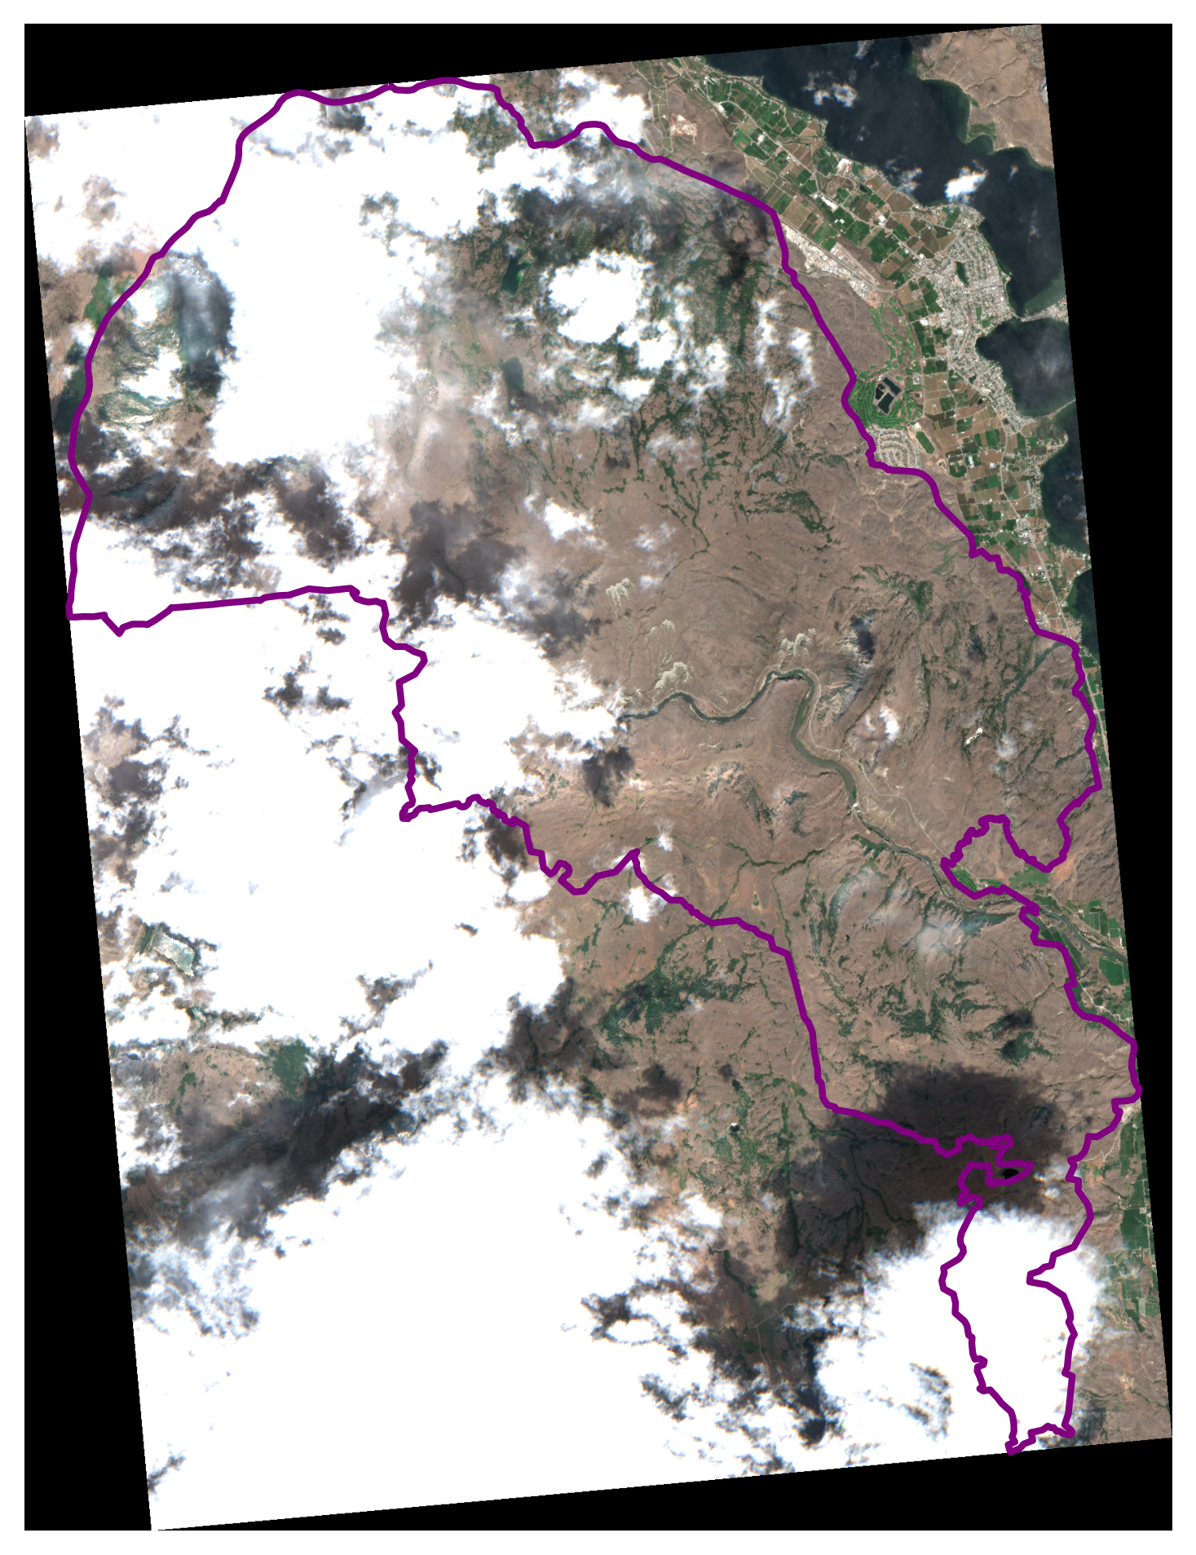
S2_2022-08-27_truecolor_pre_8bit_alt

